Slide 1


Chapter 25
Caring for People
Who Are Dying
Page - 581
Copyright@2017 Hanmi Nursing School

Slide 2


Terminal Illness
Advance Directive and Will
Attitudes toward Death and dying
Care and Support of the Dying
Postmortem
Copyright@2017 Hanmi Nursing School

Slide 3

Terminal Illness
page -582
Focus on:
The stages of grief and discuss how a person might behave during each stage
Communication techniques that you might use to support a person during each stage of grief
The role of hospice in the care of a terminally ill person
The words terminal illness, grief, hospice care, supportive care, and palliative care
Copyright@2017 Hanmi Nursing School

Slide 4
Caring for Terminally Ill People
Terminal illness: An illness or condition from which recovery is not expected
Examples of terminal illnesses:
  AIDS
  Emphysema
  Dementia
  Some types of cancers
See Tell the Nurse.
Copyright@2017 Hanmi Nursing School

Slide 5
Stages of Grief
Stages of grief:
  Denial
  Anger
  Bargaining
  Depression
  Acceptance
Throughout the grieving process, one emotion that
usually persists is hope.
See Tables 25-1 and 25-2.
Copyright@2017 Hanmi Nursing School

Slide 6
Hospice care
Care provided by a health care organization for people who are dying and their families
Supportive care:
  Treatments that will make a person more comfortable
Palliative care:
  Treatments that relieve uncomfortable symptoms
Copyright@2017 Hanmi Nursing School

Slide 7

Terminal Illness: Question
Is the following statement True or False?
Hospice care focuses on providing the family of a terminally ill person an opportunity to rest physically and emotionally.
Copyright@2017 Hanmi Nursing School

Slide 8
Terminal Illness: Answer
False
Rationale: Hospice care focuses on supportive and palliative care measures to ensure that a terminally ill person faces the end of life with comfort and dignity.
Copyright@2017 Hanmi Nursing School

Slide 9
Advance Directives and Wills
page -585
Focus on:
Ways that a person can specify his or her wishes for end-of- life care in advance
How a person can specify wishes for the management of affairs after death
The words advance directive, living will, durable power of attorney for health care, do not resuscitate (DNR) order, and will
Copyright@2017 Hanmi Nursing School

Slide 10
Advance Directives
A document where a person makes his or her wishes regarding health care known
Living wills state a person’s wish that death should not be artificially postponed. In such a case, the doctor places a do not resuscitate (DNR) order in the person’s medical record.
Durable power of attorney for health care allows the person to name someone else to make medical decisions on his or her behalf.
Copyright@2017 Hanmi Nursing School

Slide 11
Wills
A will is a legal statement that expresses a person’s wishes for the management of his or her affairs after death.
For a will to be valid, at the time it is made, the person must be deemed competent and of sound mind.
Copyright@2017 Hanmi Nursing School

Slide 12
Advance Directives: Question
Match the following terms to the correct definition.
Living will A.____ Specifies that only supportive care is
to be provided
2. DNR B. ____ Instructions about how affairs are to
be managed after death
3. Durable power C. ____ A type of advance directive
of attorney
4. Will D. ____ Names someone else to make
medical decisions on his or her behalf
Copyright@2017 Hanmi Nursing School

Slide 13
Advance Directives: Answer
1 – C, 2– A, 3– D, 4– B
1. Living will C. A type of advance directive
2. DNR A. Specifies that only supportive care is to be provided
3. Durable D. Names someone else to make power of attorney medical decisions on his or her behalf
4. Will B. Instructions about how affairs are to be managed after death
Copyright@2017 Hanmi Nursing School

Slide 14
Attitudes Toward Death and Dying
page -586
Focus on:
Factors that can affect how a person views death
Why it is important for health care workers to examine their own feelings about death
The words afterlife and reincarnation
Copyright@2017 Hanmi Nursing School

Slide 15
Cultural and Spiritual Beliefs
Attitudes toward death are influenced by such factors as:
  Cultural beliefs
  Religious or spiritual beliefs
  Previous experience with death
  Sense of accomplishment in life
  Belief in afterlife and reincarnation
See Box 25-1.
Copyright@2017 Hanmi Nursing School

Slide 16
Care & Support of the Dying Person and Family
page - 587
Focus on:
The physical changes that occur as death nears
How you can help to keep a dying person physically comfortable
How you can help to support a dying person emotionally
Ways that you can help the family of a dying person
Copyright@2017 Hanmi Nursing School

Slide 17
Physical Signs of Impending Death
As death draws near, the body begins to “shut down.”
  Circulation fails; respiratory pattern changes.
  Digestive system slows down; urine output decreases.
  Nervous system changes; consciousness may be altered.
See Table 25-3.
Copyright@2017 Hanmi Nursing School

Slide 18
Holistic Approach to Care
Promote general comfort.
Keep the room well lit.
Control odors.
Provide back massage.
Play soft music.
Read aloud.
Copyright@2017 Hanmi Nursing School

Slide 19
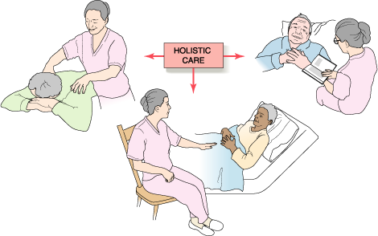
Holistic Approach to Care (cont.)
Copyright@2017 Hanmi Nursing School

Slide 20
Meeting the Dying person’s emotional Needs
Promote general comfort.
Keep the room well lit.
Control odors.
Provide back massage.
Play soft music.
Read aloud.
Copyright@2017 Hanmi Nursing School

Slide 21
Supporting the Family
Ensure good communication between the family members and the health care team.
Allow family members to stay with the dying person and participate in the person’s care if they want to.
Ensure that the family members’ basic needs are met.
Be readily available to provide needed care to the person without being intrusive of the family’s privacy.
Copyright@2017 Hanmi Nursing School

Slide 22

Supporting the Family: Question
Is this statement True or False?
Providing holistic, humanistic care means using listening and touch to help meet a dying person’s emotional needs.
Copyright@2017 Hanmi Nursing School

Slide 23
Supporting the Family: Answer
True
Rationale: Providing holistic, humanistic care means helping a dying person to meet his emotional needs as well as physical ones. Listening and touch let the person know that he is cared for and not alone.
Copyright@2017 Hanmi Nursing School

Slide 24
Postmortem Care
page - 591
Focus on:
The responsibilities you may have following the death of a patient or resident
Proper technique for providing postmortem care
The words postmortem care, rigor mortis, shroud, and autopsy
Copyright@2017 Hanmi Nursing School

Slide 25
Your Duties
If you are present when one of your patients or residents dies:
  Notify the nurse that the person has died, and note the time
  You may need to document the absence of vital signs
After the doctor has pronounced the person dead, you may be required to assist the nurse in giving postmortem care.
Copyright@2017 Hanmi Nursing School

Slide 26
Postmortem Care
Postmortem care is caring for a person’s body after the person’s death.
Cultural and religious beliefs often dictate how the body is to be cared for after death, and by whom.
Postmortem care is necessary to keep the body in proper alignment and to prevent skin damage and discoloration.
Copyright@2017 Hanmi Nursing School

Slide 27

Postmortem Care (cont.)
During postmortem care:
  Skin is cleaned of any mucus, urine, feces, or other fluids
  Body is placed in proper alignment before rigor mortis occurs
  A shroud may be applied
    See Figure 25-2.
  The person’s personal belongings are collected and packed up to send with the family
Copyright@2017 Hanmi Nursing School

Slide 28
Postmortem Care (cont.)
Autopsy
  Examination of the person’s organs and tissues after the person has died
  In most cases, the doctor is responsible for obtaining a family member’s permission to perform an autopsy.
  Medical devices such as tubes, drains, catheters, and intravenous (IV) lines are not removed as part of postmortem care.
    See Procedure 25-1.
Copyright@2017 Hanmi Nursing School

Slide 29
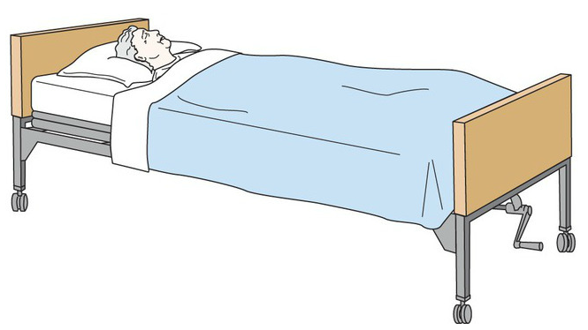
Preparing the Body for Viewing
Straighten the bed linens or change them, if necessary.
Wash the person’s body and dress the person in clean gown or pajamas.
Position the person in a natural position on the bed. Draw the top sheet to the person’s shoulders and cuff it neatly.
  See Figure 25-3.
Ensure the room is neat, adjust lights, and provide privacy.
Copyright@2017 Hanmi Nursing School

Slide 30
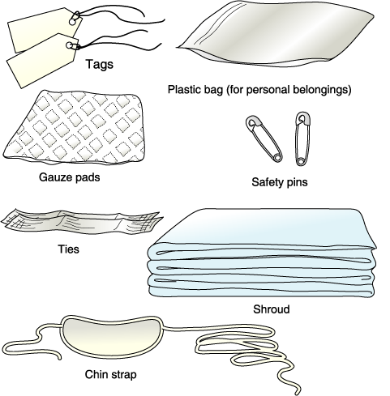
Postmortem Care: The Kit
Copyright@2017 Hanmi Nursing School

Slide 31
Postmortem Care: Question
Fill in the blanks to make a correct statement.
___________ ___________ should be taken when providing postmortem care because contact with _________ ________ is likely.
Copyright@2017 Hanmi Nursing School

Slide 32
Postmortem Care: Answer
Rationale: Standard precautions should be taken when providing postmortem care because contact with body fluids is likely.
Copyright@2017 Hanmi Nursing School

