Slide 1
Chapter 22
Assisting With
Urinary Elimination
Page - 511
Copyright@2017 Hanmi Nursing School

Slide 2
Introduction to Urinary Elimination
Assisting With Bedside Commodes, Bedpans, and Urinals
Caring for a Person With an Indwelling
Caring for a Person Who is Incontinent
Obtaining a Urine Specimen
Measuring Urine Output
Copyright@2017 Hanmi Nursing School

Slide 3
Introduction to Urinary Elimination
page - 511
Focus on:
How the urinary system helps to remove waste products
The characteristics of normal urine
Observations that you may make and report when assisting a person with urinary elimination
Actions you can take to promote normal urinary elimination
Copyright@2017 Hanmi Nursing School

Slide 4
The Urinary System
The urinary system consists of the kidneys, urinary bladder, ureters, and urethra.
Blood is filtered by the kidneys, forming urine.
The urine is stored in the urinary bladder.
As the bladder fills, we begin to feel the urge to urinate.
Urine leaves the body through the urethra.
Copyright@2017 Hanmi Nursing School

Slide 5
Characteristics of Urine
In healthy people, urine is:
Clear, without cloudiness or particles
Pale yellow, straw-colored, or dark gold (amber) in color, with a slight odor
Factors affecting the odor or appearance:
Foods and drugs
Hematuria:
A slight red tinge to the urine may indicate the presence of blood in the urine.
Copyright@2017 Hanmi Nursing School

Slide 6
Urination Habits
Factors that influence urination habits:
The amount of fluids the person drinks
The types of medications the person takes
The person’s age
The person’s lifelong elimination habits
Changes in a person’s urination habits could be:
Frequency, urgency, nocturia, and dysuria
Copyright@2017 Hanmi Nursing School

Slide 7
Promoting Normal Urinary Elimination
Encourage plenty of fluids.
Honor a person’s request for assistance with elimination as quickly as possible.
Encourage your patients or residents to call when they first feel the urge to void.
Offer bed-bound residents the chance to eliminate frequently.
Provide privacy and comfort.
The sound of running water may help some people to urinate.
See Guidelines Box 22-1.
See Tell the Nurse.
Copyright@2017 Hanmi Nursing School

Slide 8
Assisting With Bedside Commodes, Bedpans, and Urinals
page - 514
Focus on:
The equipment that may be used to assist people with
urinary elimination
The proper technique for assisting a person with a bedpan
The proper technique for assisting a person with a urinal
Copyright@2017 Hanmi Nursing School

Slide 9
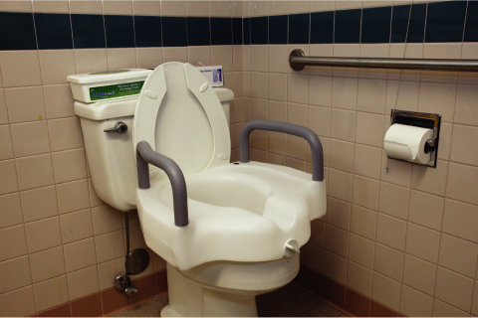
Assisting With Elimination
Some patients or residents may only need a steady arm to lean on during their trip to the bathroom; others will need more help.
The bathrooms in many health care facilities have special features that make them easier for people with physical disabilities to use.
Copyright@2017 Hanmi Nursing School

Slide 10
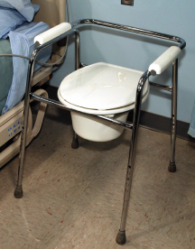
Bedside Commodes
The bedside commode consists of a chair frame with a toilet seat and a removable collection bucket.
For a person who is able to get out of bed, but who is not able to walk to the bathroom, a bedside commode can make toileting easier.
See Guidelines Box 22-2.
Copyright@2017 Hanmi Nursing School

Slide 11
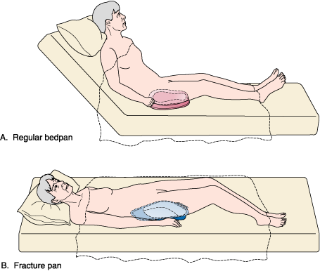
Bedpans and Fracture Pans
Patients or residents who cannot get out of bed use a bedpan for bowel movements.
Women also use bedpans to urinate.
In cases where using a bedpan is uncomfortable or dangerous, a fracture pan is used.
Copyright@2017 Hanmi Nursing School

Slide 12
Using Bedpans and Fracture Pans
Warm a metal bedpan before offering it to the patient or resident.
Dust baby powder on the seat area of the bedpan.
If the person’s condition allows, raise the head of the bed to promote a more natural elimination position.
Provide as much privacy as safely possible.
Copyright@2017 Hanmi Nursing School

Slide 13
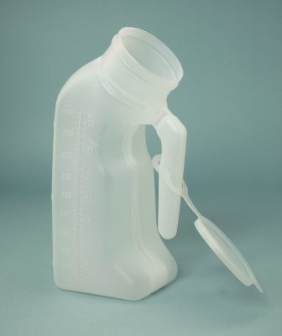
Urinals
A man uses a urinal to urinate when he cannot get out of bed.
The urinal is usually made from clear plastic and has marks on the side that make keeping track of the amount of urine voided easier.
See Procedure 22-2.
Copyright@2017 Hanmi Nursing School

Slide 14
Urinary Elimination: Question
This is a picture of a piece of equipment used to:
A. Measure urine
B. Urinate into while in bed
C. Catch urine for a urine sample
D. Drain urine from a person’s bladder
Copyright@2017 Hanmi Nursing School

Slide 15
Urinary Elimination: Answer
B. Urinate into while in bed
Rationale: This is a urinal. Although it can be used to measure urine, it’s primary to allow a man to urinate when he cannot get out of bed.
Copyright@2017 Hanmi Nursing School

Slide 16
Caring for a Person With an Indwelling Urinary Catheter
page - 518
Focus on:
Situations when an indwelling urinary catheter may need to be used
How to handle the catheter tubing and drainage bag appropriately
The proper technique for providing routine urinary catheter care
The proper technique for emptying a urine drainage bag
Observations you may make and report when caring for a person with an indwelling urinary catheter
Copyright@2017 Hanmi Nursing School

Slide 17
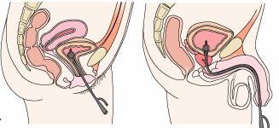
Urinary Catheterization
Urinary catheter:
Inserted into the bladder to allow the urine in the bladder to drain out
Foley or retention catheter (indwelling urinary catheter)
Copyright@2017 Hanmi Nursing School

Slide 18
Urinary Catheterization (cont.)
An indwelling urinary catheter is used when:
The person is very ill, weak, or disabled and is unable to urinate using a toilet, bedpan, urinal, or bedside commode
The bladder needs to be emptied before or during a surgical procedure
Urine needs to be collected for testing
The person is incontinent and has wounds or pressure ulcers that could be made worse by contact with urine
Copyright@2017 Hanmi Nursing School

Slide 19
Providing Catheter Care
Urinary tract infections in catheterized people are among the most common nosocomial infections.
Catheter care:
Reduces the risk of nosocomial infection in people with indwelling urinary catheters
Provided as per facility requirements
Provided when perineal area becomes soiled
Soap and water or a special antibacterial solution may be used.
See Procedure 22-3.
See Guidelines Box 22-3.
Copyright@2017 Hanmi Nursing School

Slide 20
Types of Urine Drainage Bags
Some bags have a long length of tubing that allows them to be carried or secured to a bed frame or the back of a wheelchair.
“Leg bags” are connected to the catheter by a short length of tubing and secured to the person’s thigh.
All urine drainage bags have a connection adapter and an emptying spout that is opened to allow urine to drain from the bag.
See Figure 22-3.
See Tell the Nurse.
Copyright@2017 Hanmi Nursing School

Slide 21
Emptying Urine Drainage Bag
Urine drainage bags are routinely emptied and the urine is measured at the end of each shift.
Urine drainage bags should also be emptied if they are full.
Leg bags need to be emptied frequently because they are smaller and hold less urine.
See Procedure 22-4.
Copyright@2017 Hanmi Nursing School

Slide 22
Indwelling Catheter: Question
Is the following statement True or False?
Indwelling urinary catheters are a leading cause of health care–associated infections (HAIs).
Copyright@2017 Hanmi Nursing School

Slide 23
Indwelling Catheter: Answer
True
Rationale: Indwelling urinary catheters are a leading cause of health care–associated infections (HAIs).
Copyright@2017 Hanmi Nursing School

Slide 24
Caring for a Person Who Is Incontinent of Urine
page - 523
Focus on:
The types of urinary incontinence
How urinary incontinence can affect a person both physically
and emotionally
The products that are available to help manage urinary
incontinence and the proper use of these products
How bladder training is used to assist people who are
incontinent of urine
Copyright@2017 Hanmi Nursing School

Slide 25
Urinary Incontinence
The involuntary loss of urine from the bladder
Urinary incontinence can cause:
Skin problems (such as rashes and pressure ulcers)
Falls and accidents (as the person rushes to the bathroom)
Urinary incontinence can be:
Temporary
Permanent
Copyright@2017 Hanmi Nursing School

Slide 26
Types of Urinary Incontinence
Stress incontinence
Urge incontinence
Functional incontinence
Overflow incontinence
Reflex incontinence
Copyright@2017 Hanmi Nursing School

Slide 27
Managing Urinary Incontinence
Urinary incontinence can be managed with:
Incontinence pads
Incontinence briefs
Bed protectors
Condom catheters
See Figure 22-4.
To prevent skin breakdown:
Ensure good perineal care
Keep skin, clothing, and bed linens dry
Copyright@2017 Hanmi Nursing School

Slide 28
Condom Catherters
A condom catheter consists of a soft plastic or rubber sheath, tubing, and a collection bag for the urine. The sheath is placed over the penis and the collection bag is attached to the leg.
Copyright@2017 Hanmi Nursing School

Slide 29
Bladder Training
To help people relearn how to control their urinary elimination patterns
To schedule elimination to promote regular emptying of the bladder
To be able to control involuntary urination
To be able to get to the bathroom in time to avoid accidents
Copyright@2017 Hanmi Nursing School

Slide 30
Urinary Incontinence: Question
The main types of urinary incontinence include:
(Select all that apply.)
A. Stress
B. Urge
C. Functional
D. Overflow
E. Reflex
F. Intentional
Copyright@2017 Hanmi Nursing School

Slide 31
Urinary Incontinence: Answer
A, B, C, D, and E
Rationale: The five main types of urinary incontinence are stress incontinence, urge incontinence, functional incontinence, overflow incontinence, and reflex incontinence. People are rarely intentionally incontinent.
Copyright@2017 Hanmi Nursing School

Slide 32
Obtaining a Urine Specimen
page - 526
Focus on:
The proper technique for collecting a routine urine
specimen
The proper technique for collecting a midstream
(“clean catch”) urine specimen
Copyright@2017 Hanmi Nursing School

Slide 33
Collecting a Routine Urine Specimen
Routine urinalysis:
Urine is collected in the specimen cup.
Midstream (“clean catch”) urine specimen:
The area around the urethral opening is cleaned with a special cleansing wipe.
The person begins to urinate, then stops, and then starts again. The urine sample is collected from the restarted flow.
See Guidelines Box 22-4.
See Procedure 22-5.
Copyright@2017 Hanmi Nursing School

Slide 34
Measuring Urine Output
page - 528
Focus on:
Methods used to measure and record urine output
Copyright@2017 Hanmi Nursing School

Slide 35
Measuring Urine Output (cont.)
Urine output indicates:
The functioning of the person’s kidney
Whether or not the person is maintaining a good fluid balance
Urine output is measured in:
People who have illnesses
People who take medications that may affect the fluid balance
Copyright@2017 Hanmi Nursing School

Slide 36
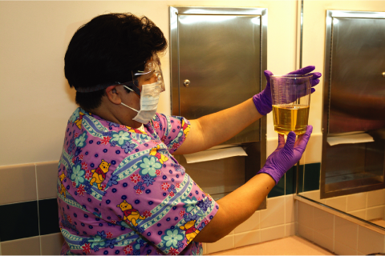
Measuring Urine Output (cont.)
Urine is collected in:
Specimen collection devices
Urinals
Drainage bags used with urinary catheters
Graduate
Urine output is recorded in intake and output flow sheets.
See Figure 22-5.
Copyright@2017 Hanmi Nursing School

Slide 37
Collecting a Specimen: Question
In this picture, the nursing assistant is protecting herself best by:
A. Using standard precautions
B. Working in the utility room
C. Covering her nose and mouth
D. Holding the urine away from
her body
Copyright@2017 Hanmi Nursing School

Slide 38
Collecting a Specimen: Answer
A. Using standard precautions
Rationale: Standard precautions provides the nursing assistant with the best protection when there is a possibility of coming into contact with body fluids like urine.
Copyright@2017 Hanmi Nursing School

