Slide 1


Chapter 10
Infection Control(감염 통제) Page -219
Copyright@2017 Hanmi Nursing School

Slide 2


Infection Control (감염 통제)
Copyright@2017 Hanmi Nursing School

Slide 3

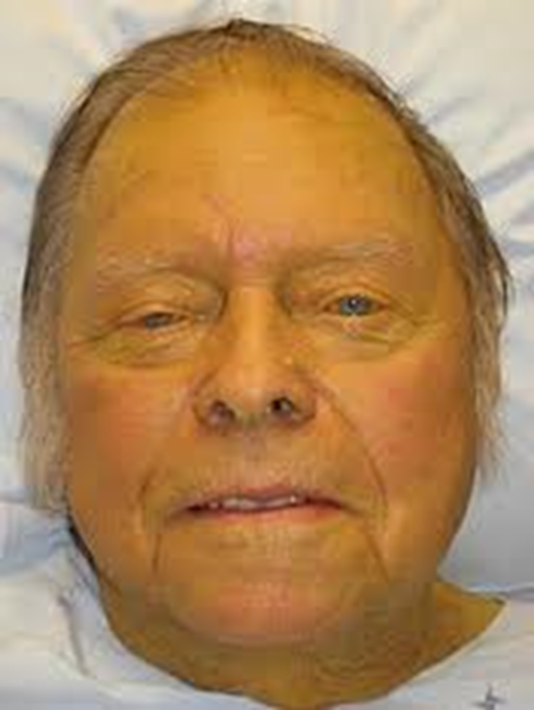
Cause of Infection
Copyright@2017 Hanmi Nursing School

Slide 4
Hepatitis
Hepatitis
Copyright@2017 Hanmi Nursing School

Slide 5


Hepatitis
I Have Infectious Hepatitis!
Copyright@2017 Hanmi Nursing School

Slide 6
Cause of Infection
Focus on:
The different types of germs (세균)that can cause disease
The conditions that promote the growth of germs
Copyright@2017 Hanmi Nursing School

Slide 7
Infection
Microbes(미생물): Living organisms that cannot be seen with the naked eye
Pathogen(병원균): A microbe that can cause disease
Infection: An illness caused by pathogens or germs
Communicable infections(전염성 감염): Infections that can spread from one person to another
Copyright@2017 Hanmi Nursing School

Slide 8
Infection (cont.)
Microbes are generally classified as bacteria, viruses, fungi(곰팡이), or parasites(기생충).
Most pathogens prefer an environment that is warm, moist, dark, and with proper amounts of oxygen.
Copyright@2017 Hanmi Nursing School

Slide 9
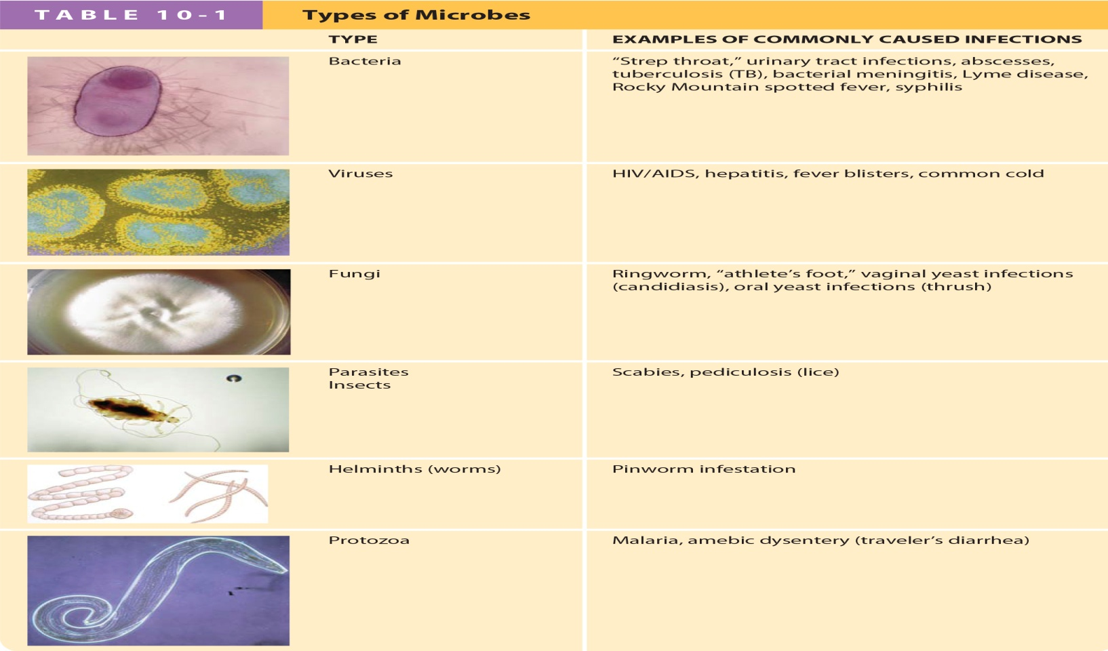
Classification of Microbes
Copyright@2017 Hanmi Nursing School

Slide 10
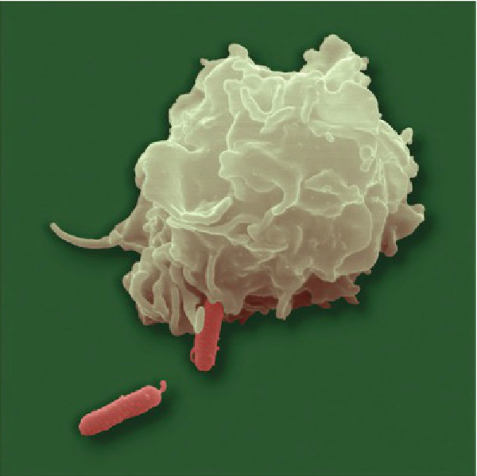
백혈구
사진을
넣으세요
세균
Copyright@2017 Hanmi Nursing School

Slide 11

Infection (인헥션) 과 Inflammation (염증) 염증(inflammation)과 감염(infection)의 차이
염증(infammation)이 감염 보다 더 넓은 의미입니다. 즉, 염증이 꼭 감염을 의미하는 것은 아닙니다. 염증은 우리 몸의 면역반응의 일종입니다. 피도 더 많이 모이고 백혈구도 모이고 여러가지 물질들도 나옵니다. 이 과정에서 붉게 변하고 붇기도 하고 진물이 나기도 하고 통증도 생깁니다. 류마티즘과 같이 자가 면역질환은 우리 몸의 면역체계가 우리 몸을 적으로 인식해서 파괴하는 과정에서 생기는 염증입니다. 퇴행성 관절염은 많이 쓰고 힘이 많이 가해져서 관절연골이 닳아서 뼈끼리 부딪히면서 염증반응이 생겨서 아픈 것이구요. 통풍은 요산이라는 우리 몸의 노폐물이 농도가 짙어져서 결정을 만들면 이 결정이 염증을 일으켜서 붇고 아픈 것입니다.
감염(infection)은 반드시 바이러스, 곰팡이, 세균등 병원성 미생물의 외부의 침입에 의해 생긴 염증을 말하므로 보다 좁은 의미입니다.(병원성이라고 지칭하는 것은 모든 세균이나 바이러스가 병을 일으키는 것이 아니기 때문에 병을 일으키는 원인이 될 수 있는 것만 말하는 것입니다. 우리 몸의 피부에는 피부 상재균이 있는데도 아무런 문제를 일으키지않고 오히려 도움이 되기도 합니다.)
이 외부의 적 침입을 막아내기 위한 우리 몸의 방어기능으로 염증 반응이 일어나는 것이 감염입니다. 물론 감염이 되려면 병원성 미생물만의 존재로는 안됩니다. 감염은 우리 몸에 병원성 미생물이 들어와서 염증반응을 일으켜야지만 성립이 되는 것이기 때문이죠. 쉬운 예로 세균이 득실대는 대변이 늘 접촉하고 있는 대장과 항문에 감염증상이 없는 이유죠. 화상이나 살짝 베인 상처에도 처음에는 단순한 염증이지만 병원균이 들어가면 감염으로 진행될 수 있습니다. 피부는 매우 중요한 우리 몸의 방어막인데 화상이나 상처가 이 방어막을 손상시켜서 병원성 미생물의 침입에 약해지는 것입니다. 그렇다고 모든 상처가 감염으로 진행되지 않는 것은 우리 몸이 면역등 자기 방어 기능을 추가로 작동시키기 때문입니다. 감염 을 전염과 혼동 하면 안됨
Copyright@2017 Hanmi Nursing School

Slide 12
Infection: Question
Is the following statement True or False?
Microbes that cause illness are called pathogens. (질병을 일으키는 균을 병원성 균 이라고 한다 )
Copyright@2017 Hanmi Nursing School

Slide 13
Infection: Answer
True
Rationale: Pathogens are microbes that cause illness. Page – 221 Helminths - 회충과 같은 가늘고 긴 연충 Protozoa – 아메바 와 같은 원충
Copyright@2017 Hanmi Nursing School

Slide 14
The Immune System
The body’s defenses against pathogens
1. Nonspecific defense:
Help to protect us from all infections
2. Specific defense:
Help to protect us only from certain infections
Copyright@2017 Hanmi Nursing School

Slide 15
1. Nonspecific Defense Mechanisms
Healthy skin:
Clean, dry skin without cuts, scrapes, or wounds
Healthy mucous membranes(점막):
The sticky mucus they secrete traps and destroys pathogens.
Copyright@2017 Hanmi Nursing School

Slide 16
1. Nonspecific Defense Mechanisms (cont.)
In an infection:
Blood vessels around the site of infection dilate, allowing more blood to flow to the area.
White blood cells destroy pathogens that invade the body.
See Figure 10-1.
Copyright@2017 Hanmi Nursing School

Slide 17
1. Nonspecific Defense Mechanisms (cont.)
The person develops a fever causing the pathogens to die in the hot environment.
Signs and symptoms(증상) of an infection:
Redness
Warmth
Pain
Swelling
Copyright@2017 Hanmi Nursing School

Slide 18
Defenses Against Infection
page -222
Focus on:
The defense mechanisms (방어기전)the body uses to fight infection :
skin (피부), Mucous membrane (점막) – First Line of Defence ( 제 1차 방어막)
Defining the word antibodies(항체) : 우리 몸의 면역 기관 에서 병원균과 대항하기 위해 만들어진 특수 단백질The different types of germs (세균)that can cause disease
The conditions that promote the growth of germs
Copyright@2017 Hanmi Nursing School

Slide 19
2. Specific Defense Mechanisms
Antibodies:
Specialized proteins produced by the immune system that help our bodies to fight off specific pathogens
Our bodies produce antibodies through:
Previous infection with the pathogen
Vaccination(접종)
10-1.
Copyright@2017 Hanmi Nursing School

Slide 20
Medications
Many medications are available to help us fight infections:
Antibiotics: Used to treat bacterial infections
Antimicrobials: Used to treat fungal and parasitic infections
Antivirals: Used to treat viral infections
Copyright@2017 Hanmi Nursing School

Slide 21
Ways Infections Are Transmitted
page -224
Focus on:
The airborne route of transmission
The direct route of transmission
The oral-fecal route of transmission
The bloodborne route of transmission
Identifying body fluids that are most likely to contain bloodborne pathogens
Copyright@2017 Hanmi Nursing School

Slide 22
Ways Infections Are Transmitted (cont.)
The airborne route of transmission
Some infections are transmitted through the air. The person becomes infected when he or she breathes contaminated air.
Infections: Tuberculosis (TB), measles(홍역), and chickenpox(수종)
Copyright@2017 Hanmi Nursing School

Slide 23
MERS : Middle East Respiratory Syndrome ( 중동 호흡기 증후근 )
SARS - Severe Acute Respiratory Syndrome (중증 급성 호흡기 증후근) Ebola Virus syndrome
Copyright@2017 Hanmi Nursing School

Slide 24
Ways Infections Are Transmitted (cont.)
The direct route of transmission
Some infections are transmitted through contact with an infected person or objects that the infected person has used.
Infections: Herpes and conjunctivitis(각막염)
Copyright@2017 Hanmi Nursing School

Slide 25
Ways Infections Are Transmitted (cont.)
The oral-fecal route of transmission
Some infections are transmitted when feces containing a pathogen contaminate food or water that is then consumed by another person.
Infections: Hepatitis A, hepatitis E, and some types of parasitic infections
See Figure 10-2.
Copyright@2017 Hanmi Nursing School

Slide 26
Ways Infections Are Transmitted (cont.)
The bloodborne route of transmission
Identifying body fluids that are most likely to contain bloodborne pathogens
Infections: Hepatitis B, hepatitis C, hepatitis D, and HIV infection/AIDS
Copyright@2017 Hanmi Nursing School

Slide 27
Bloodcorne Trnasmission
Blood or body fluids from an infected person enter the bloodstream of an uninfected person:
Needlesticks, cuts
Direct contact between blood and broken skin, mucous membranes, or the eyes
See Figure 10-3.
Body fluids include:
Blood, semen, vaginal secretions, wound drainage, cerebrospinal fluid, amniotic fluid, and breast milk
Copyright@2017 Hanmi Nursing School

Slide 28
Defenses Against Infection: Question
Is the following statement True or False?
Our first line of defense against infection includes medications and vaccinations.
Copyright@2017 Hanmi Nursing School

Slide 29
Defenses Against Infection: Question
False
Rationale: Our first line of defense against infection includes healthy skin and mucous membranes.
Copyright@2017 Hanmi Nursing School

Slide 30
Chain of Infection
Focus on:
The six key conditions that must be met for an infection to be spread from one person to another Page-227
How the chain of infection can be broken
Copyright@2017 Hanmi Nursing School

Slide 31
Chain of infection (cont.)
For a person to get a communicable infection, six key conditions must be met. Page - 227
Eliminating any one of the six key elements breaks the chain and prevents the spread of infection.
Copyright@2017 Hanmi Nursing School

Slide 32
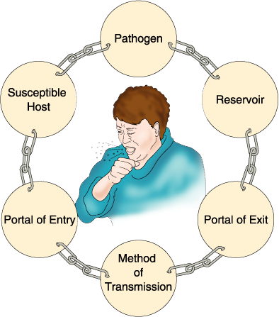
Chain of infection (cont.)
Copyright@2017 Hanmi Nursing School

Slide 33
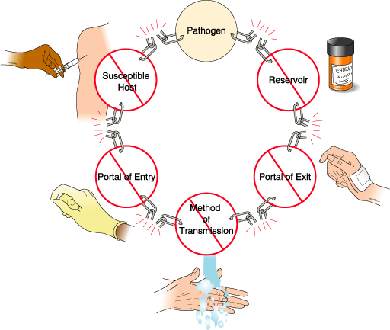
Braking the infection (cont.)
Copyright@2017 Hanmi Nursing School

Slide 34
Chain of infection (cont.)
Eliminating any one of the six key elements breaks the chain and prevents the spread of infection.
Copyright@2017 Hanmi Nursing School

Slide 35
Chain of Infection: Question
Which are elements of the chain of infection? (Select all that apply.)
A. Pathogen
B. Reservoir
C. Portal of exit
D. Portal of entry
E. Healthy skin
Copyright@2017 Hanmi Nursing School

Slide 36
Chain of Infection: Answer
A, B, C, and D
Rationale: The chain of infection describes the elements that must be present for an infection to occur. The six elements of the chain of infection are pathogen, reservoir, portal of exit, method of transmission, portal of entry, and susceptible host.
Copyright@2017 Hanmi Nursing School

Slide 37
Methods of Infection Control
Focus on:
Ways that a person could get an infection within the health care system
The four major methods of infection control
The four techniques that make up the practice of medical asepsis
Handwashing as the single most important method of preventing the spread of infection
Copyright@2017 Hanmi Nursing School

Slide 38
Methods of Infection Control (cont.)
Personal protective equipment’s (PPE) role in infection control
How isolation precautions help prevent infection
How airborne, droplet, contact, and standard precautions are used
Tuberculosis (TB), an airborne infection that poses a special risk to health care workers
Diseases caused by bloodborne pathogens and how the viruses that cause these diseases affect the body
Copyright@2017 Hanmi Nursing School

Slide 39
Infection Control
Infection control:
Basic practices designed to decrease the spread of an infection from one person to another
See Box 10-1.page - 230
See Guidelines Box 10-2.page-233
Nosocomial infection (원내, 병원내 감염):
An infection acquired while in a health care facility
Copyright@2017 Hanmi Nursing School

Slide 40
Infection Control (cont.)
Four major methods of infection control:
Medical asepsis(무균, 멸균)
Surgical asepsis
Barrier methods( 차단벽 방법)
Isolation precautions
Copyright@2017 Hanmi Nursing School

Slide 41
Medical Asepsis
Goal: To remove pathogens from surfaces, equipment, and the hands of health care workers
See Table 10-2. page-232
Prevention: Proper handwashing – 아주 중요!
Visibly soiled hand: Use soap and water.
Hands are not visibly soiled: Use alcohol-based hand rub.
See Procedure 10-1 (page-244)and Box 10-2.
Copyright@2017 Hanmi Nursing School

Slide 42
Surgical Asepsis
Involves sterilization of all instruments and equipment used for procedures that involve entering a person’s body, such as:
Surgical procedures
Injections
Insertion of intravenous (IV) catheters
Insertion of urinary catheters
Copyright@2017 Hanmi Nursing School

Slide 43
Barrier Methods
Use of personal protective equipment (PPE)
Best order for putting on PPE:
Mask (See Figure 10-6) page-236
Protective eyewear (See Figure 10-7)-page-236
Gowns (See Procedures 10-3 and 10-4) page 247 and page -248
Gloves (See Guidelines Box 10-2 and Procedure 10-2) page-246
Copyright@2017 Hanmi Nursing School

Slide 44
Isolation Precautions
Isolation precautions are guidelines followed to contain the pathogen and limit its exposure to others as much as possible.
Transmission-based precautions:
Used when a person is known or thought to have an infection that is transmitted in a certain way
Copyright@2017 Hanmi Nursing School

Slide 45
Barrier Methods: Question
Is the following statement True or False?
For handwashing to be effective in preventing the spread of infection, it must be performed thoroughly, properly, and consistently.
Copyright@2017 Hanmi Nursing School

Slide 46
Barrier Methods: Answer
True
Rationale: Handwashing is the single most effective method of preventing the spread of infection. For handwashing to be effective in preventing the spread of infection, it must be performed thoroughly, properly, and consistently.
Copyright@2017 Hanmi Nursing School

Slide 47
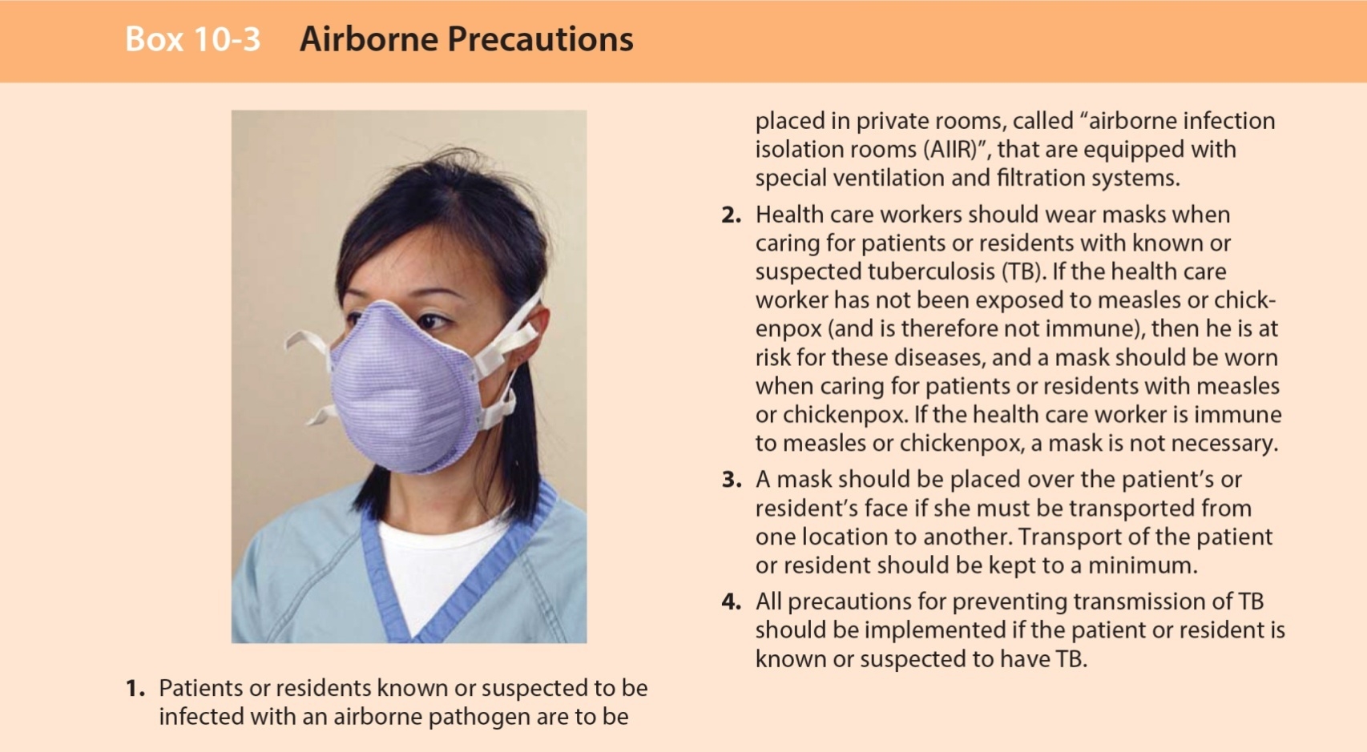
Transmission-Based Precautions
page -237
Airborne Precautions
Copyright@2017 Hanmi Nursing School

Slide 48
Transmission-Based Precautions (cont.)
Airborne pathogens:
Measles
Chickenpox(수두)
Tuberculosis (TB)
See Box 10-4. –page 238
Copyright@2017 Hanmi Nursing School

Slide 49
Transmission-Based Precautions (cont.)
Droplet precautions:
Similar to airborne precautions
A mask must be used when you are within 3 feet of the infected person.
Pathogens transmitted in droplets:
Influenza, whooping cough(백일해), strep throat (연쇄상 세균 감염), scarlet fever(성홍열), rubella(풍진), meningitis(뇌막염), pneumonia(폐염), diphtheria(디프테리아), and epiglottitis(목젓, 후두개염)
Copyright@2017 Hanmi Nursing School

Slide 50
Transmission-Based Precautions (cont.)
Contact precautions:
Precautions taken when caring for people with diseases caused by pathogens that can be transmitted directly or indirectly
See Procedure 10-7.page-251
Contact diseases:
Skin and wound infections
Digestive tract infections
Some respiratory tract infections
Copyright@2017 Hanmi Nursing School

Slide 51
Standard Precautions
Bloodborne pathogens:
Hepatitis B virus (HBV)
Hepatitis C virus (HCV)
Hepatitis D virus (HDV)
Human immunodeficiency virus (HIV)
See Boxes 10-5 and 10-6. page-239, 240 * HAV and HEV are through fecal –oral transmission
Copyright@2017 Hanmi Nursing School

Slide 52
Transmission Based Precautions: Question
Is the following statement True or False?
Standard precautions are taken only with patients or residents who have an infectious disease.
Copyright@2017 Hanmi Nursing School

Slide 53
Transmission Based Precautions: Question
False
Rationale: Standard precautions are taken with every patient or resident.
Copyright@2017 Hanmi Nursing School

Slide 54
OSHA Bloodborne Pathogens Standard
Focus on:
The standards set by the Occupational Safety and Health Administration (OSHA) to protect health care workers from exposure to bloodborne pathogens in the workplace
How the employer and the employee share the responsibility for maintaining the employee’s safety in the workplace
Copyright@2017 Hanmi Nursing School

Slide 55
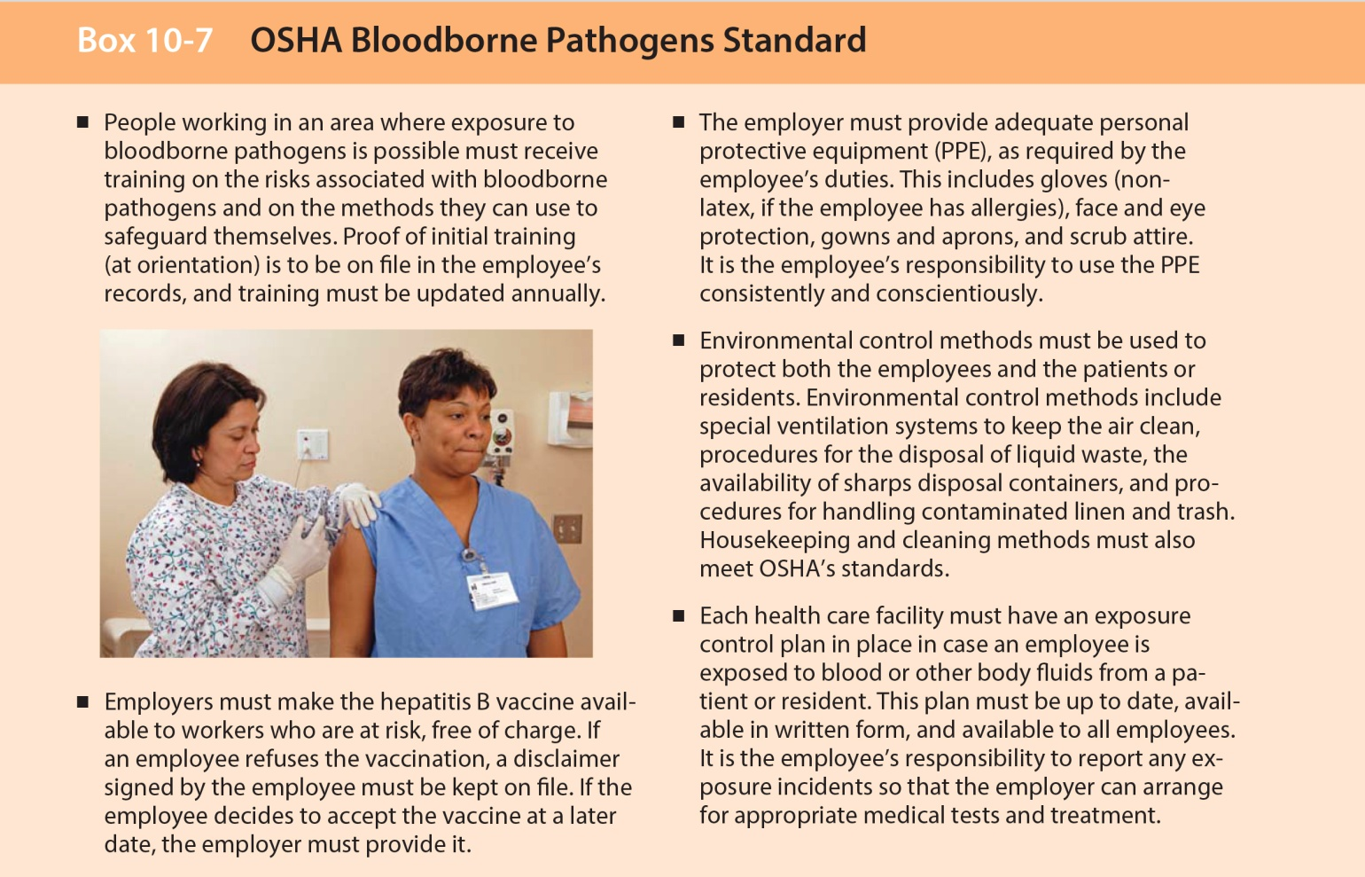
OSHA Bloodborn Pathogens Standard (cont.)
Copyright@2017 Hanmi Nursing School

