Slide 1
Chapter 13
Basic First Aid &
Emergency Care
Page - 292
Copyright@2017 Hanmi Nursing School

Slide 2
Responding to an Emergency
Basic Life Support (BLS) Measures
Emergency Situations
Copyright@2017 Hanmi Nursing School

Slide 3
Responding to an Emergency
page -293
Focus on:
The nursing assistant's role in an emergency
The meaning of the words “disoriented,” unresponsive,” and “basic life support”
Copyright@2017 Hanmi Nursing School

Slide 4
Emergency
What is an emergency?
A condition that requires immediate medical or surgical evaluation or treatment in order to prevent the person from dying or having a permanent disability
Copyright@2017 Hanmi Nursing School

Slide 5
Nursing Assistant’s Role
Disoriented is the state of being unable to answer basic questions about person, place, or time; a state of confusion.
Unresponsive is when a person is unconscious and cannot be aroused, or conscious but not responsive when spoken to or touched.
Copyright@2017 Hanmi Nursing School

Slide 6
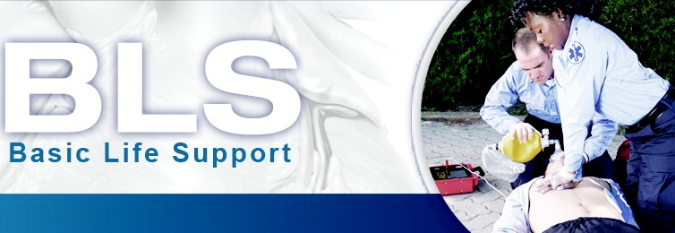
Nursing Assistant’s Role (cont.)
Basic life support (BLS) includes basic emergency care techniques, such as rescue breathing, cardiopulmonary resuscitation (CPR), and the use of an automated external defibrillator (AED).
Copyright@2017 Hanmi Nursing School

Slide 7
Nursing Assistant’s Responsibilities
Responsibilities of a nursing assistant in case of an emergency include:
Recognizing that an emergency exists
Deciding to act
Checking for consciousness
Activating the facility’s emergency response system
Providing appropriate care until the emergency personnel arrive
Copyright@2017 Hanmi Nursing School

Slide 8
Basic Life Support (BLS) Measures
page -294
Focus on:
The measures included in basic life support (BLS)
The organizations that offer approved training in (BLS) measures
What respiratory and cardiac arrests are
Copyright@2017 Hanmi Nursing School

Slide 9
Basic Life Support Measures (cont.)
The goal of BLS:
To prevent respiratory arrest (a condition where breathing has stopped)
To prevent cardiac arrest (a condition where the heart has stopped)
BLS measures perform breathing and circulation for someone who is unable to perform these functions independently and training is offered by:
The American Red Cross (ARC)
The National Safety Council (NSC)
American Heart Association (AHA)
Copyright@2017 Hanmi Nursing School

Slide 10
Basic Life Support Measures (cont.)
A—Check airway.
B—Check for breathing.
C—Check for circulation.
Check for bleeding.
Copyright@2017 Hanmi Nursing School

Slide 11
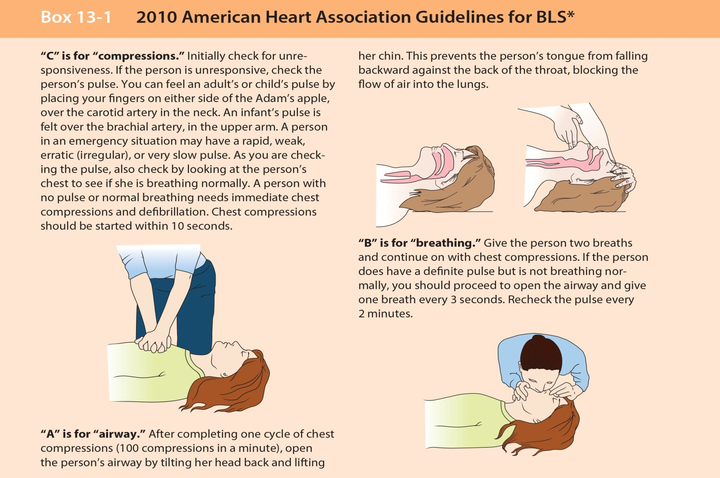
Basic Life Support
Copyright@2017 Hanmi Nursing School

Slide 12
Basic Life Support Measures: Question
Is this statement True or False?
In an emergency situation, basic life support (BLS) measures are used to keep a person alive until more advanced emergency help is available.
Copyright@2017 Hanmi Nursing School

Slide 13
Basic Life Support Measures: Answer
True
Rationale: It is true that in an emergency situation, basic life support (BLS) measures are used to keep a person alive until more advanced emergency help is available.
Copyright@2017 Hanmi Nursing School

Slide 14
Emergency Situtions
page -295
Focus on:
The signs and symptoms of a "heart attack" and how a nursing assistant would help
The signs and symptoms of a stroke
How a nursing assistant would help a person who complains of feeling faint or who has fainted
How a nursing assistant would help a person who is having a seizure
Copyright@2017 Hanmi Nursing School

Slide 15
Emergency Situations (cont.)
Focus on:
How a nursing assistant would help a person who is bleeding uncontrollably (hemorrhaging)
The types and causes of shock and how a nursing assistant would help a person who is in shock
Situations that can put a person at risk for choking
How to perform abdominal thrusts or chest thrusts
Copyright@2017 Hanmi Nursing School

Slide 16
Emergency Situations (cont.)
Heart attack
Stroke
Fainting (syncope)
Seizures
Hemorrhage
Shock
Airway obstruction
Copyright@2017 Hanmi Nursing School

Slide 17
Fainting
Blood supply to the brain suddenly decreases, resulting in a loss of consciousness.
Although fainting may be an early sign of a serious medical condition, such as a heart problem, it can also be the result of hunger, pain, extreme emotion, fatigue, medication side effects, a “stuffy” room, excessive heat, or standing for a long time.
Copyright@2017 Hanmi Nursing School

Slide 18
Fainting - First Aid
If you believe that a person is about to faint:
Loosen any restraints or tight clothing (such as a belt or necktie), have the person lie down in the supine position and elevate his legs 12 inches, or ask him to sit down and bend forward, placing his head between his knees for at least 5 minutes
See Figure 13-2.
Copyright@2017 Hanmi Nursing School

Slide 19
Fainting - First Aid (cont.)
Fainting is not life threatening in itself, but a person who faints is at risk for injury from falling.
If a person you are assisting does faint:
Lower him to the floor, remembering to use good body mechanics
Make sure the person is breathing, and call for help
Have him continue to lie down until the nurse arrives
Copyright@2017 Hanmi Nursing School

Slide 20
Fainting - First Aid (cont.)
What to report when a person faints:
What time the person fainted
Whether there was a change in the person’s level of consciousness and how long this change lasted
Whether the person vomited
The person’s appearance at the time of the incident
Whether the person complained of anything before the incident
The actions taken to assist the person
Copyright@2017 Hanmi Nursing School

Slide 21
Emergency Situations: Question
Fill in the blank to make a correct statement.
Fainting is not life threatening in itself, but a person who faints is at risk for injury from ________.
Copyright@2017 Hanmi Nursing School

Slide 22
Emergency Situations: Answer
Fainting is not life threatening in itself, but a person who faints is at risk for injury from falling.
Copyright@2017 Hanmi Nursing School

Slide 23
Seizures
Seizures or convulsions occur when brain activity is interrupted.
Seizures can result from head injuries (either recent or past), strokes, infections, high fevers, poisonings, brain tumors, and epilepsy.
Types of seizures include:
Grand mal seizure
Petit mal seizure
Copyright@2017 Hanmi Nursing School

Slide 24
Seizures - Signs and Symptoms
Grand mal seizures are characterized by generalized and violent contraction and relaxation of the body’s muscles.
During a petit mal (absence) seizure, the person may stare into space or stop speaking in midsentence, only to “come back” a few moments later.
Copyright@2017 Hanmi Nursing School

Slide 25
Seizures - First Aid
First aid for a person having a grand mal seizure involves:
Protecting the person until the seizure is over
Keeping the airway open during the period of unconsciousness
Copyright@2017 Hanmi Nursing School

Slide 26
Seizures - First Aid (cont.)
If a person is having a grand mal seizure, you would:
Help the person to the floor and move furniture or other objects that might cause injury out of the way
Protect the person’s head by placing a pillow or folded towel underneath it and call for help while allowing the seizure to run its course
Copyright@2017 Hanmi Nursing School

Slide 27
Seizures - First Aid (cont.)
Never place anything in the person’s mouth or between the teeth.
The gag reflex may be temporarily lost; saliva may pool in the mouth. After the seizure is over, turn the person to his side (in the recovery position) and allow any secretions to drain from his mouth to prevent choking.
Provide warmth and a quiet environment.
Copyright@2017 Hanmi Nursing School

Slide 28
Hemorrhage
Hemorrhage (severe, uncontrolled bleeding) can be caused by trauma to a blood vessel or by certain illnesse, such as gastric ulcers.
Hemorrhage can be:
External (visible)
Internal (within the body)
Copyright@2017 Hanmi Nursing School

Slide 29
Hemorrhage – First Aid
In the event of an emergency situation where a person is hemorrhaging, call for help and make sure the person is lying down.
Take standard precautions to protect yourself from exposure to bloodborne pathogens.
Copyright@2017 Hanmi Nursing School

Slide 30
Hemorrhage – First Aid (cont.)
Apply firm, steady pressure directly to the wound using a sterile dressing, a clean towel, or whatever else is clean and available for use as a compress.
If the direct pressure does not stop or slow the flow of blood, raise the affected body part (if it is an arm or leg) and apply pressure to a pulse point above the wound.
See Figure 13-4.
Copyright@2017 Hanmi Nursing School

Slide 31
Emergency Situations: Question
Is this statement True or False?
If a person is having a grand mal seizure, the nursing assistant would hold the person tightly to decrease his or her risk for being injured.
Copyright@2017 Hanmi Nursing School

Slide 32
Emergency Situations: Answer
False
Rationale: If a person is having a grand mal seizure, the nursing assistant would help the person to the floor and move furniture or other objects that might cause injury out of the way.
Copyright@2017 Hanmi Nursing School

Slide 33
Shock
Shock results when the organs and tissues of the body do not receive enough oxygen-rich blood.
To treat shock, the underlying cause of the shock must be addressed.
Copyright@2017 Hanmi Nursing School

Slide 34
Shock (cont.)
Types | Causes
Cardiogenic | Occurs when the heart is unable to pump enough blood throughout the body
Hemorrhagic | Results from massive blood loss
Septic | Caused by severe bacterial infections
Anaphylactic | Caused by severe allergic reactions
Copyright@2017 Hanmi Nursing School

Slide 35
Shock - Signs and Symptoms
A person entering a state of shock will:
Have a low blood pressure
Have a pulse that is rapid and weak
Have cool, clammy, and pale skin
Be confused or disoriented
Breathe rapidly, and if he is conscious, he may complain of thirst
Copyright@2017 Hanmi Nursing School

Slide 36
Shock - First Aid
Keep the person warm and calm.
The treatment for anaphylactic shock is the immediate administration of a medication called epinephrine.
Copyright@2017 Hanmi Nursing School

Slide 37
Airway Obstruction
Type | Symptoms
Partial airway obstruction with good air exchange | The person coughs strongly and has good skin color.
Copyright@2017 Hanmi Nursing School

Slide 38
Airway Obstruction (cont.)
Type | Symptoms
Partial airway obstruction with poor air exchange | The person’s coughing is a weak, ineffective effort with high-pitched, “crowing” sounds as he tries to breathe; bluish skin color.
Complete airway obstruction | The person cannot cough, speak, or breathe and might lose consciousness quickly.
Copyright@2017 Hanmi Nursing School

Slide 39
Airway Obstruction - First Aid
First aid to be administered in case of choking:
Clearing the airway in adults and children older than 1 year:
Abdominal thrusts
Chest thrusts; used on very heavy people or pregnant women
Copyright@2017 Hanmi Nursing School

Slide 40
Airway Obstruction - First Aid
Clearing the airway in infants:
In children younger than 1 year, the Heimlich maneuver is not used because of the risk for damaging the baby’s internal organs.
Instead, a combination of back blows and chest thrusts is used.
Copyright@2017 Hanmi Nursing School

Slide 41
Airway Obstruction: Question
A person experiencing a complete obstruction of his or her airway is not able to:
A. Speak
B. Walk
C. Make a fist
D. Grasp his or her throat
Copyright@2017 Hanmi Nursing School

Slide 42
Airway Obstruction: Answer
A. Speak
Rationale: The person whose airway is completely obstructed cannot cough, speak, or breathe and will lose consciousness quickly if the object that is blocking airflow is not removed.
Copyright@2017 Hanmi Nursing School

