Slide 1
Chapter 26
Caring for People
With Dementia
Page - 598
Copyright@2017 Hanmi Nursing School

Slide 2
Introduction to Dementia
Types of Dementia
Behaviors Associated with Dementia
Caring for a person with Dementia
Effects on the Caregiver
Copyright@2017 Hanmi Nursing School

Slide 3
Introduction to Dementia
page -599
Focus on:
Problems related to thinking and remembering that a person with dementia experiences
The difference between dementia and delirium
Changes in a normally alert person that could signal delirium and should be reported to the nurse
The words dementia, activities of daily living (ADLs), and delirium
Copyright@2017 Hanmi Nursing School

Slide 4
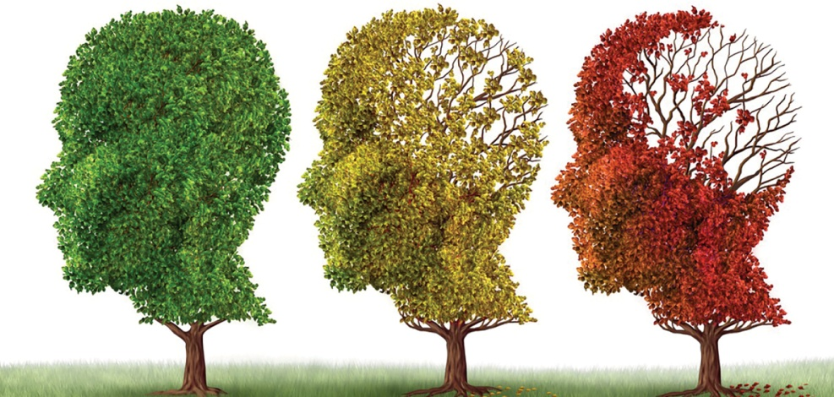
Dementia
A person with dementia experiences:
Problems with judgment and memory, especially short-term memory
Difficulty putting thoughts together and understanding concept
Confusion
Inability to manage activities of daily living (ADLs)
Copyright@2017 Hanmi Nursing School

Slide 5
Delirium
A temporary state of confusion
Sign of an underlying disorder, such as an infection
Once the cause of delirium is discovered and treated, the delirium goes away.
See Tell the Nurse.
Copyright@2017 Hanmi Nursing School

Slide 6
Introduction to Dementia: Question
Is the following statement True or False?
Dementia is confusion in a person who is normally alert and oriented and goes away when the underlying cause is treated.
Copyright@2017 Hanmi Nursing School

Slide 7
Introduction to Dementia: Answer
False
Rationale: Dementia should not be confused with delirium. Delirium is confusion in a person who is normally alert and oriented. Delirium goes away when the underlying cause is treated.
Copyright@2017 Hanmi Nursing School

Slide 8
Types for Dementia
page -600
Focus on:
Most common types of dementia
The three stages of dementia
Copyright@2017 Hanmi Nursing School

Slide 9
Types for Dementia (cont.)
Two of the most common types:
Alzheimer’s disease
Vascular (multi-infarct) dementia
Copyright@2017 Hanmi Nursing School

Slide 10
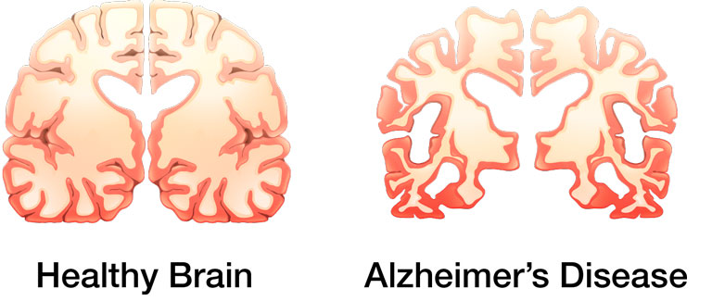
Alzheimer’s Disease
Abnormal deposits of protein, called plaques and tangles, develop in the brain.
The protein deposits interfere with the way that the nerves inside the brain communicate with each other.
Copyright@2017 Hanmi Nursing School

Slide 11
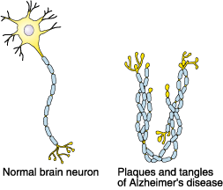
Alzheimer’s Disease (cont.)
Copyright@2017 Hanmi Nursing School

Slide 12
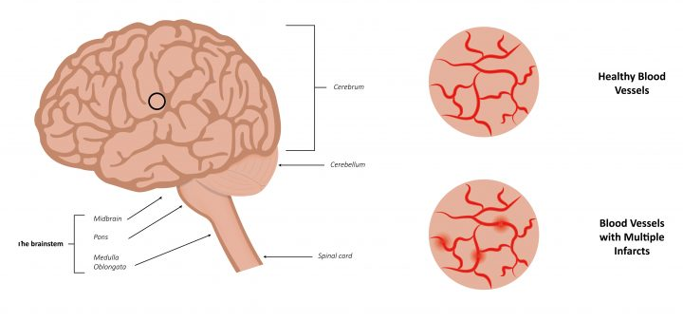
Vascular (Multi-Infarct) Disease
Damage to the blood vessels that supply the brain can decrease the amount of oxygen and nutrients that are delivered to the brain tissue.
Mental functions are lost because multiple areas of the brain tissue die because of a lack of adequate oxygen and nutrients.
Most often affects people between the ages of 55 and 75 years
Copyright@2017 Hanmi Nursing School

Slide 13
Ricks for Developing Vascular Dementia
Myocardial infarction (heart attack)
Hypertension (high blood pressure)
Diabetes mellitus
Peripheral vascular disease
Transient ischemic attacks (TIAs)
Obesity
Smoking
High blood cholesterol levels
Copyright@2017 Hanmi Nursing School

Slide 14
Types of Dementia: Question
Is the following statement True or False?
A person diagnosed with Alzheimer’s disease has damage to the blood vessels in his or her brain causing parts of the brain tissue to die.
Copyright@2017 Hanmi Nursing School

Slide 15
Types of Dementia: Answer
False
Rationale: In people with vascular (multi-infarct) dementia, damage to the blood vessels in the brain blocks the flow of oxygen and nutrients, causing parts of the brain tissue to die.
Copyright@2017 Hanmi Nursing School

Slide 16
Behaviors Associated With Dementia
page - 602
Focus on:
Behaviors that are common in people with dementia
Strategies for managing difficult behaviors in people
with dementia
The word validation therapy
Copyright@2017 Hanmi Nursing School

Slide 17
Behaviors Associated With Dementia (cont.)
Wandering
Pacing
“Sundowning”
Rummaging
Delusions
See Box 26-2.
Hallucinations
Agitation
Catastrophic reactions
Repetition (perseveration)
Inappropriate sexual behavior
See Table 26-1.
Copyright@2017 Hanmi Nursing School

Slide 18
Managing Difficult Behavior
When caring for a person with dementia who is demonstrating a particular behavior, you must use your observation skills to try and answer the following questions:
What is the behavior?
Who is the behavior associated with?
When does the behavior occur?
Where does the behavior occur?
Copyright@2017 Hanmi Nursing School

Slide 19
Validation Therapy
Technique used to respond to some behaviors
Validation therapy acknowledges the person’s reality, instead of trying to get the person to accept your reality.
Instead of correcting the person, you respond to what the person is telling you while gently redirecting the conversation.
See Table 26-2.
Copyright@2017 Hanmi Nursing School

Slide 20
Behaviors Associated With Dementia: Question
Match the following behavior with a way to manage it.
A. ____ Ask the person what he or she is looking for and offer to help find it.
B. ____ Provide distraction.
C. ____ Use gentle touch, play soothing music, or sing to the person.
D. ____ If the person wears glasses, make sure they are in place.
1. Sundowning
2. Hallucinations
3. Catastrophic reaction
4. Rummaging
Copyright@2017 Hanmi Nursing School

Slide 21
Behaviors Associated With Dementia: Answer
1– D, 2– B, 3– C, and 4– A
1. Sundowning
2. Hallucinations
3. Catastrophic reaction
4. Rummaging
D. If the person wears glasses, make sure they are in place.
B. Provide distraction.
C. Use gentle touch, play soothing music, or sing to the person.
A. Ask the person what he or she is looking for and offer to help find it.
Copyright@2017 Hanmi Nursing School

Slide 22
Caring for a Person With Dementia
page - 606
Focus on:
Special considerations while helping a person with dementia with activities of daily living (ADLs)
Special care measures to help maintain quality of life for a person with dementia
The word reminiscence therapy
Copyright@2017 Hanmi Nursing School

Slide 23
Meeting the Physical Needs
Assisting with ADLs will be smoother if you:
Speak clearly, in a calm tone of voice
Gently touch the person
Remind the person at each step what he or she needs to do next
Copyright@2017 Hanmi Nursing School

Slide 24
Meeting the Physical Needs (cont.)
Assisting with ADLs will be smoother if you (cont.):
Use hand gestures in addition to spoken instructions
Plan for the procedure in advance
Keep to a regular schedule
See Guidelines Box 26-1.
Copyright@2017 Hanmi Nursing School

Slide 25
Assisting With Bathing
Bath time can be a frightening time for a person with dementia.
The sound of running water, the bright lights, and the shiny surfaces in the tub room can be very upsetting.
Being naked makes the person feel exposed and vulnerable.
The person may be very afraid of falling.
Copyright@2017 Hanmi Nursing School

Slide 26
Assisting With Bathing (cont.)
Singing and music can have a very calming effect on people with dementia.
Prepare the tub room in advance.
Use a bath blanket to make the person feel less exposed.
See Figure 26-2
Let the person assist as much as possible.
Copyright@2017 Hanmi Nursing School

Slide 27
Assisting With Dressing
Limit the number of outfits the person has to choose from so that selecting an outfit becomes easier.
People often want to wear the same clothes every day.
Select articles of clothing that are simple to wear and can be easily put on and fastened.
Copyright@2017 Hanmi Nursing School

Slide 28
Assisting With Eating
A quiet setting and limited food choices can help.
You may need to remind the person how to eat by placing your hand over the person’s hand.
Ensure that the person is swallowing the food after chewing it.
Observe for signs of choking.
See Figure 26-3
Copyright@2017 Hanmi Nursing School

Slide 29
Assisting With Elimination
The person may forget where the bathroom is or fail to recognize the toilet.
The person may be unable to move clothing out of the way fast enough.
Take the person to the bathroom on a regular schedule.
Assist the person in selecting clothing with fasteners that are easy to manage.
Copyright@2017 Hanmi Nursing School

Slide 30
Meeting the Emotional Needs
Reminiscence therapy:
Encourages the person to talk about the past. This diverts the person’s attention and increases his or her self-esteem.
Activity therapy:
Helps the person feel useful and gives him or her a sense of purpose and accomplishment
Copyright@2017 Hanmi Nursing School

Slide 31
Caring for a Person With Dementia: Question
A nursing assistant will do which of the following when helping a resident with dementia do his or her ADLs? (Select all that apply.)
A. Prepare for procedures in advance
B. Provide clear step-by-step instructions
C. Speak in a loud voice
D. Use gentle touch as necessary
E. Keep to a regular schedule
Copyright@2017 Hanmi Nursing School

Slide 32
Caring for a Person With Dementia: Answer
A, B, D, and E
Rationale: People with dementia need help to do their ADLs. Preparing for procedures in advance; providing clear step-by-step instructions in a calm voice; using hand gestures and gentle touch as necessary; and keeping to a regular schedule are actions you can take to help ensure that procedures go smoothly.
Copyright@2017 Hanmi Nursing School

Slide 33
Effects on the Caregiver
page - 613
Focus on:
How caring for a person with dementia can affect you
Strategies that can help you to cope
Copyright@2017 Hanmi Nursing School

Slide 34
Effects on the Caregiver (cont.)
Caring for a person with dementia can take its toll on you, physically and emotionally.
The person can physically harm you in an outburst of anger.
Many of the behaviors can be very annoying because they are repetitious.
Exhaustion and fatigue can put you on edge, making it difficult for you to keep your emotions in check.
Copyright@2017 Hanmi Nursing School

Slide 35
Effects on the Caregiver (cont.)
A person with dementia cannot be held responsible for his or her actions.
Make sure the person is safe and walk away if you are angry.
Ask a co-worker or the nurse for help with the person.
Ask to be assigned to another resident for a while.
Copyright@2017 Hanmi Nursing School

Slide 36
Effects on the Caregiver: Question
Fill in the blanks to make a true statement.
To provide the best care to your patients or residents, you need to ____ for ______.
Copyright@2017 Hanmi Nursing School

Slide 37
Effects on the Caregiver: Answer
To provide the best care to your patients or residents, you need to care for yourself.
Copyright@2017 Hanmi Nursing School

