Slide 1
Psychological Aging Mental Illness
PCA Training Program
Heisung Lee, Ph D

Slide 2
Basic human needs
When a person’s psychosocial needs are not met the response may include
Frustration (좌절감)
Stress
Fear
Anxiety ( 불안감)
Anger
Aggression (투기적, 반항적)
Withdrawal (상실)
Depression

Slide 3
Maslow’s Hierarchy of Needs

Slide 4
Myths About Older Adults and Sexuality
• Myth #1: Older men are not capable of having sexual relations.
There are some physical changes that may alter the way a couple engages in sexual relations. Men may need more direct contact, may take longer, and may need longer between relations to perform again. However, many men continue to have satisfying relations well into old age.
• Myth #2: After menopause women are not interested in sexual relations.
Many women relax and enjoy sex more in later years. With no fear of pregnancy and older children leaving home, many women feel much freer. There may be some physical changes, such as less lubrication, but there are remedies available. Communication with a woman’s physician is important. The reason many older women stop having sexual relations is because they lose their partners when their partners die.

Slide 5
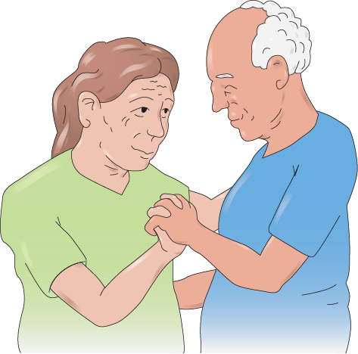
• Myth #3: Any expression of sexuality by older people is either disgusting or cute.
This attitude deprives older people of their right to dignity and respect. Older adults have the same needs and rights to express their sexuality as other age groups, and they may do so in the same ways. In all age groups there is a wide variety of behavior. This is true of older people also.
It is true, however, that our society discourages this expression by the messages sent through jokes, advertisements, and the media. Older people see and hear these messages and may believe that there is something wrong with them if they feel or act on their desires.

Slide 6
Losses with older adults
Elderly may be experiencing any of these losses:
Loss of spouse, family, or friends
Loss of workplace and its relationships
Loss of ability to go places
Loss of ability to attend religious services and meetings
Loss of home and personal possessions
Loss of health and ability to care for themselves
Loss of ability to move freely
Loss of pets

Slide 7
독립성을 잃으면
Loss of independence can cause
Poor self-image (초라하게 느낌)
Anger
Feelings of helplessness, sadness, and hopelessness
Feelings of uselessness (무용지물)
Increased dependence (의존성 증가)
Depression

Slide 8
Discuss developmental disabilities
The following are important points about intellectual disabilities:
Not a disease or psychiatric illness
Involve below-average mental functioning
May have limited ability to live independently
Have the same emotional and physical needs as others

Slide 9
Discuss developmental disabilities
NAs should remember the following when caring for residents with an intellectual disability:
Treat adult residents as adults.
Praise and encourage often.
Help teach ADLs by dividing a task into smaller units.
Promote independence.
Encourage social interaction.
Repeat words you use to make sure they understand.
Be patient.

Slide 10
Describe some types of mental illness
Define the following terms:
apathy
a lack of interest.
major depressive disorder
a type of depression that causes withdrawal, lack of energy, and loss of interest in activities, as well as other symptoms; also called major depression.
bipolar disorder
a type of depression that causes a person to swing from periods of deep depression to periods of extreme activity; also called manic-depressive illness.

Slide 11
Describe some types of mental illness
Define the following terms:
anxiety
uneasiness or fear, often about a situation or condition.
phobia
an intense form of anxiety or fear.
claustrophobia
the fear of being in a confined space.
panic disorder
a disorder in which a person has repeated episodes of intense fear that something bad will occur.

Slide 12
Describe some types of mental illness
Define the following terms:
obsessive-compulsive disorder (OCD)
an anxiety disorder characterized by obsessive behavior or thoughts.
post-traumatic stress disorder (PTSD)
an anxiety disorder caused by a traumatic experience.
schizophrenia
a form of mental illness that affects a person’s ability to think, communicate, make decisions, and understand reality.

Slide 13
Describe some types of mental illness
Define the following terms:
obsessive-compulsive disorder (OCD)
an anxiety disorder characterized by obsessive behavior or thoughts.
post-traumatic stress disorder (PTSD)
an anxiety disorder caused by a traumatic experience.
schizophrenia
a form of mental illness that affects a person’s ability to think, communicate, make decisions, and understand reality.

Slide 14
Describe some types of mental illness
Define the following terms:
hallucinations
seeing, hearing, smelling, tasting, or feeling things that are not there.
delusions
false beliefs.
psychotherapy
a method of treating mental illness that involves talking about one’s problems with mental health professionals.

Slide 15
Describe some types of mental illness
When caring for residents with mental illness it is important to observe for and report the following:
Changes in ability
Positive or negative mood changes (withdrawal)
Behavior changes
Comments about hurting self or others (including jokes)
Failure to take medicine
Real or imagined physical symptoms
Events, situations, or people that provoke certain reactions

